Slide 1
Healthy Learning, Healthy Lives Award Key Stage 0 (Early years)
Quick reference guide
For more information and a breakdown of these criteria, go to www.healthylearningdoncaster.co.uk
Physical Activity | Criteria 1 Policy The setting has a Physical Activity Policy, or equivalent. | Criteria 2 Environment The setting is conducive to and encourages opportunities for age/ability appropriate active play | Criteria 3 Teaching and learning Staff are positive role models and actively promote evidence based physical activity within the setting | Criteria 4 CPD/training Staff have a good understanding and knowledge of the importance of physical activity and current recommendations and guidelines. Staff are aware of the implications of sedentary behaviours. | Criteria 5 Partnerships The benefits of physical activity are actively promoted with the community. Families are encouraged to be active and engage in active travel. | Enhanced Criteria (Optional): You can apply for an Enhanced Award once you have gained your Healthy Learning, Healthy Lives Award.
Food Drink and Oral Health | Criteria 1 Policy The setting has a food and drink Policy with section that also clearly relates to oral health. | Criteria 2 Environment The setting promotes a positive eating environment. Children are encouraged to enjoy eating, develop positive eating habits and social skills through mealtimes. | Criteria 3 Teaching and learning Staff are positive role models and children are encouraged to learn through play in respect of food, drink and oral health. | Criteria 4 CPD/training Staff receive training and have knowledge of current food, drink, nutritional and oral health recommendations and messages and this is evident in practice | Criteria 5 Partnerships The setting is committed to ensuring all children are given the best start in life through safe and responsive infant feeding methods and relationship building practices | Enhanced Criteria (Optional): You can apply for an Enhanced Award once you have gained your Healthy Learning, Healthy Lives Award.
Lifestyle influences | Criteria 1 Policy The setting has an emotional health and wellbeing policy, and a sun safety policy, or equivalent. Sun safety is also embedded within or captured in a policy document. | Criteria 2 Environment The setting has a dedicated health promotion display for staff, children and families. The outside area has a dedicated shaded play area and there are dedicated sleep/quite areas for the children. | Criteria 3 Teaching and learning The setting supports the health and wellbeing of staff members and employees are role models for families and children | Criteria 4 CPD/training Staff members have a good understanding of the importance of emotional health and wellbeing of the child and of sun safety. | Criteria 5 Partnerships The setting has positive partnerships with parent/carers and actively transfers positive health behaviours to the home environment and promotes local and national champagnes | Enhanced Criteria (Optional): You can apply for an Enhanced Award once you have gained your Healthy Learning, Healthy Lives Award.

Slide 3
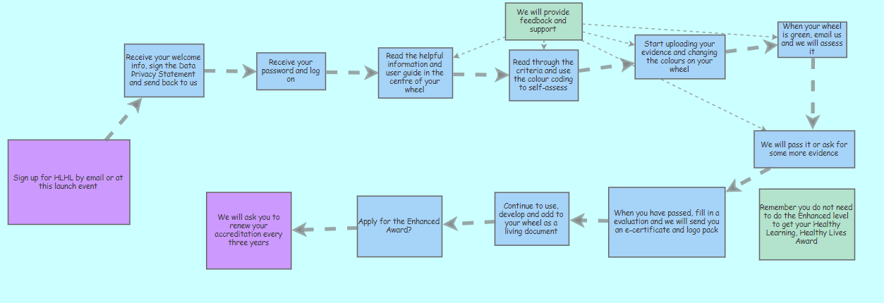
HLHL Accreditation Process
www.healthylearningdoncaster.co.uk
healthylearning@doncaster.gov.uk

